Slide 1


Slide 2


Slide 3
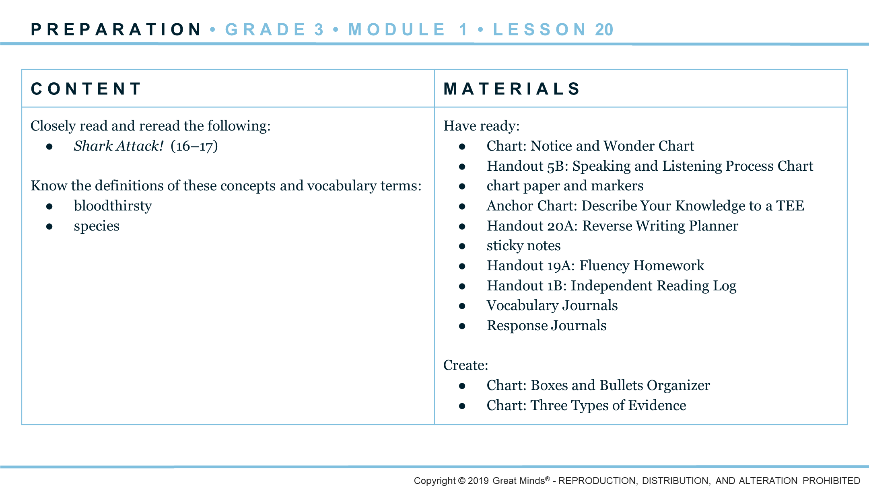
Notes:
Essential Question: Why do people explore the sea?
Focusing Question: How and why do scientists explore sea creatures?
Content Framing Question: ORGANIZE: What is happening in Shark Attack!?
Craft Question: EXAMINE: Why is it important to develop a topic with facts, definitions, and details?

Slide 4
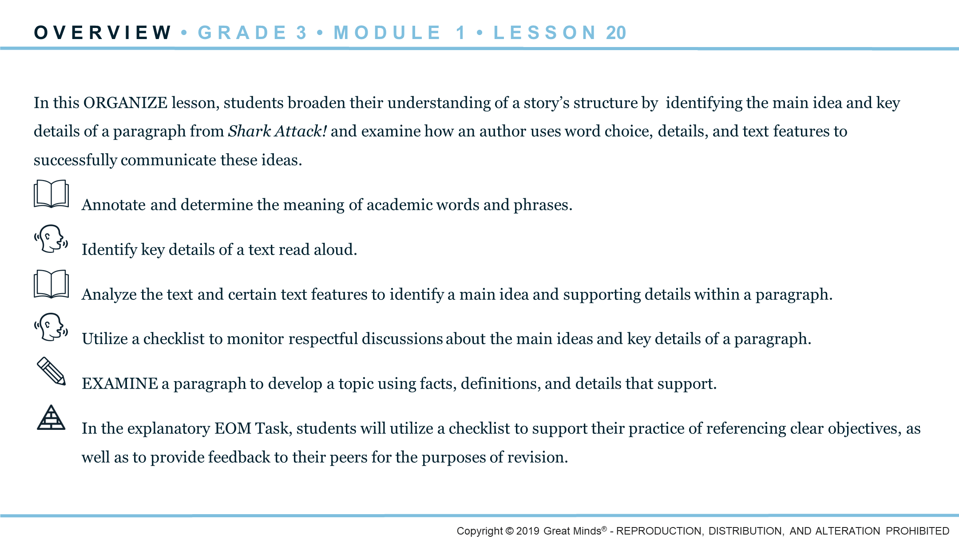
Notes:
Agenda
Welcome (5 min.)
Examine Text Features
Launch (5 min.)
Learn (55 min.)
Listen to a Text Read Aloud (10 min.)
Identify the Main Idea and Key Details in a Paragraph (10 min.)
Identify the Main Idea and Key Details in a Passage (15 min.)
Examine How to Develop a Topic Using Facts, Definitions, and Details (20 min.)
Land (5 min.)
Answer the Content Framing Question for Example
Wrap (5 min.)
Assign Homework

Slide 5
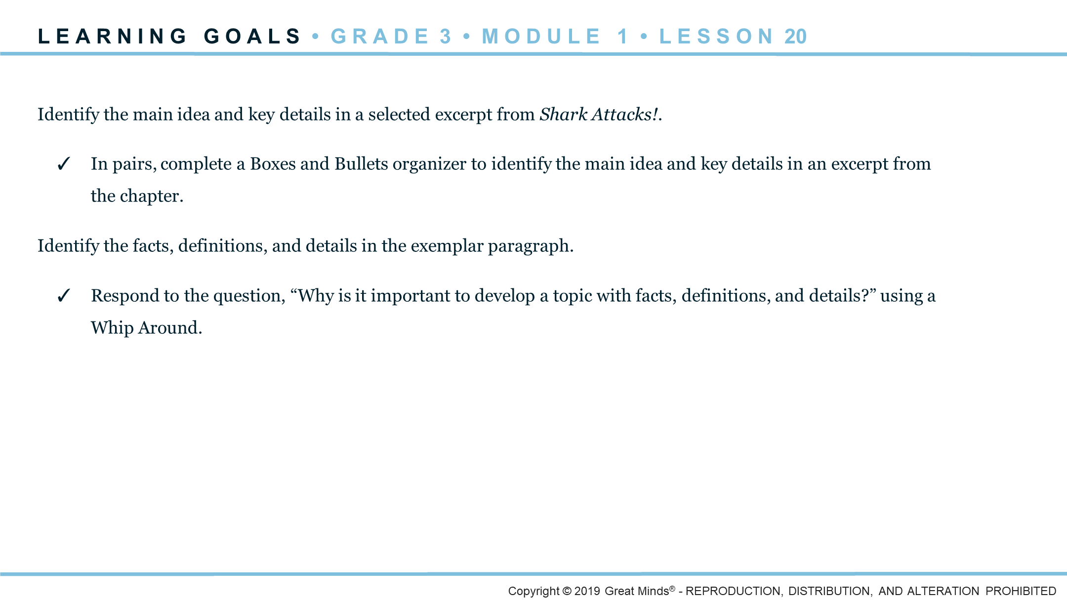
Notes:
Standards
Reading: RI.3.2, RI.3.4, RL.3.5, RL.3.7
Writing: W.3.2.b
Speaking and Listening: SL.3.1, SL.3.2
Language: L.3.4.d

Slide 6
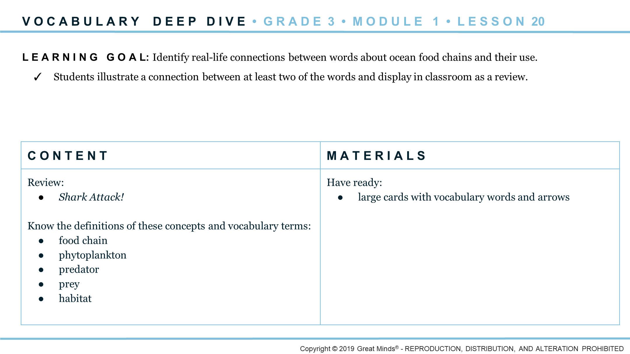
Notes:
Standards
Language: L.3.5.b

Slide 8
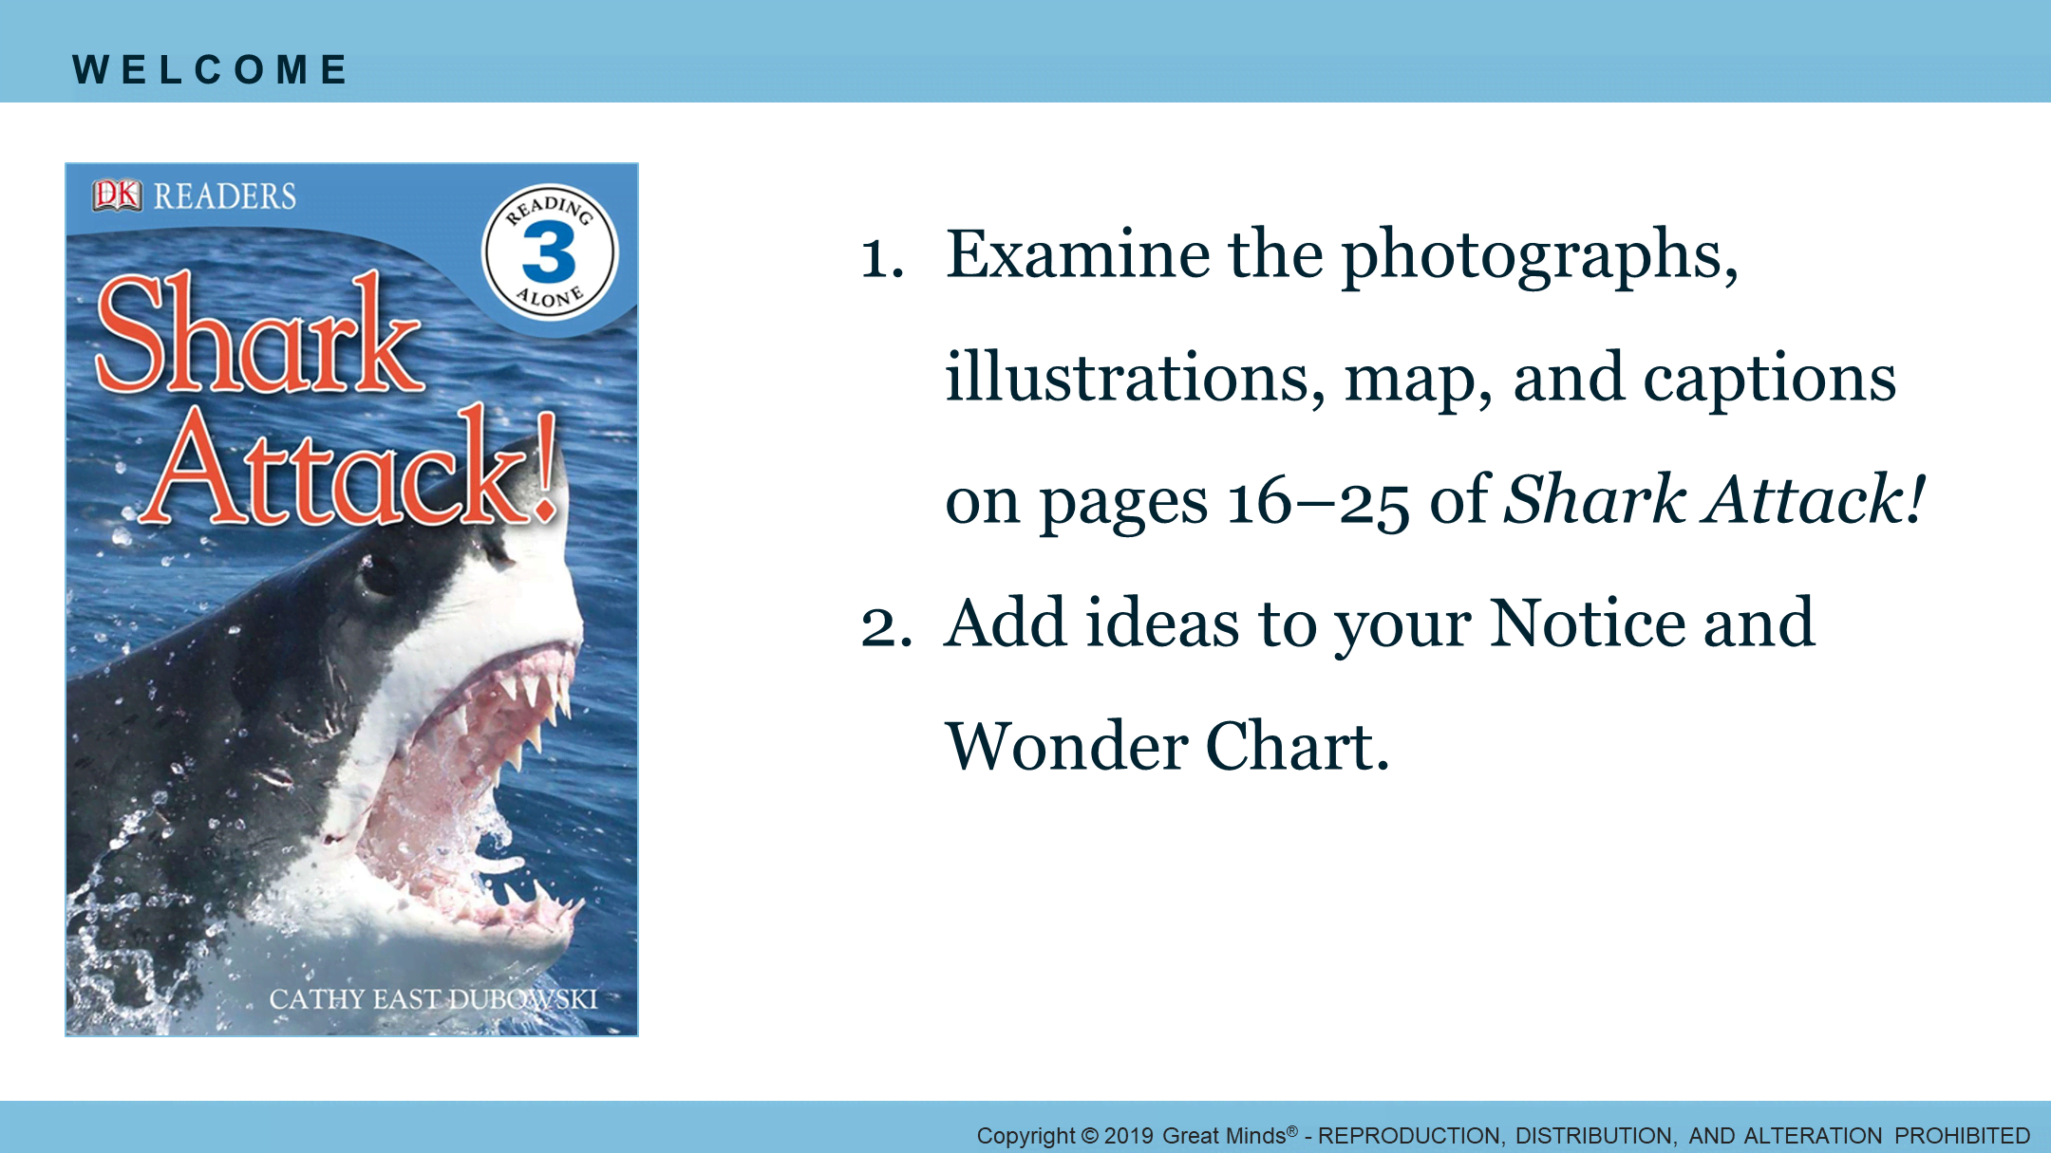
Notes:
Welcome 1/1
Pacing Suggestion: 5 min.
Grouping: Pairs
Teacher Actions
Have students complete the Welcome activity in pairs.
Encourage students to focus on the text features within this section.

Slide 9
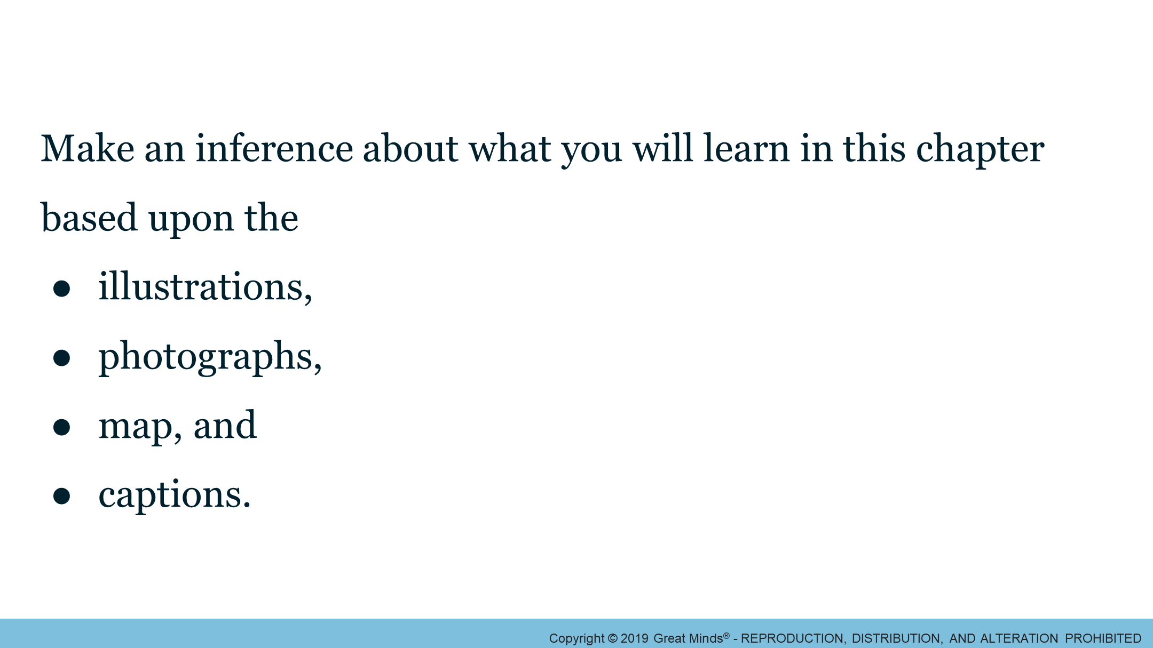
Notes:
Launch 1/3
Pacing Suggestion: 2 min.
Grouping: Whole Group
Teacher Actions
Guide discussion, and encourage students to share any new questions they have and place in the appropriate column of their Notice and Wonder Chart.

Slide 10
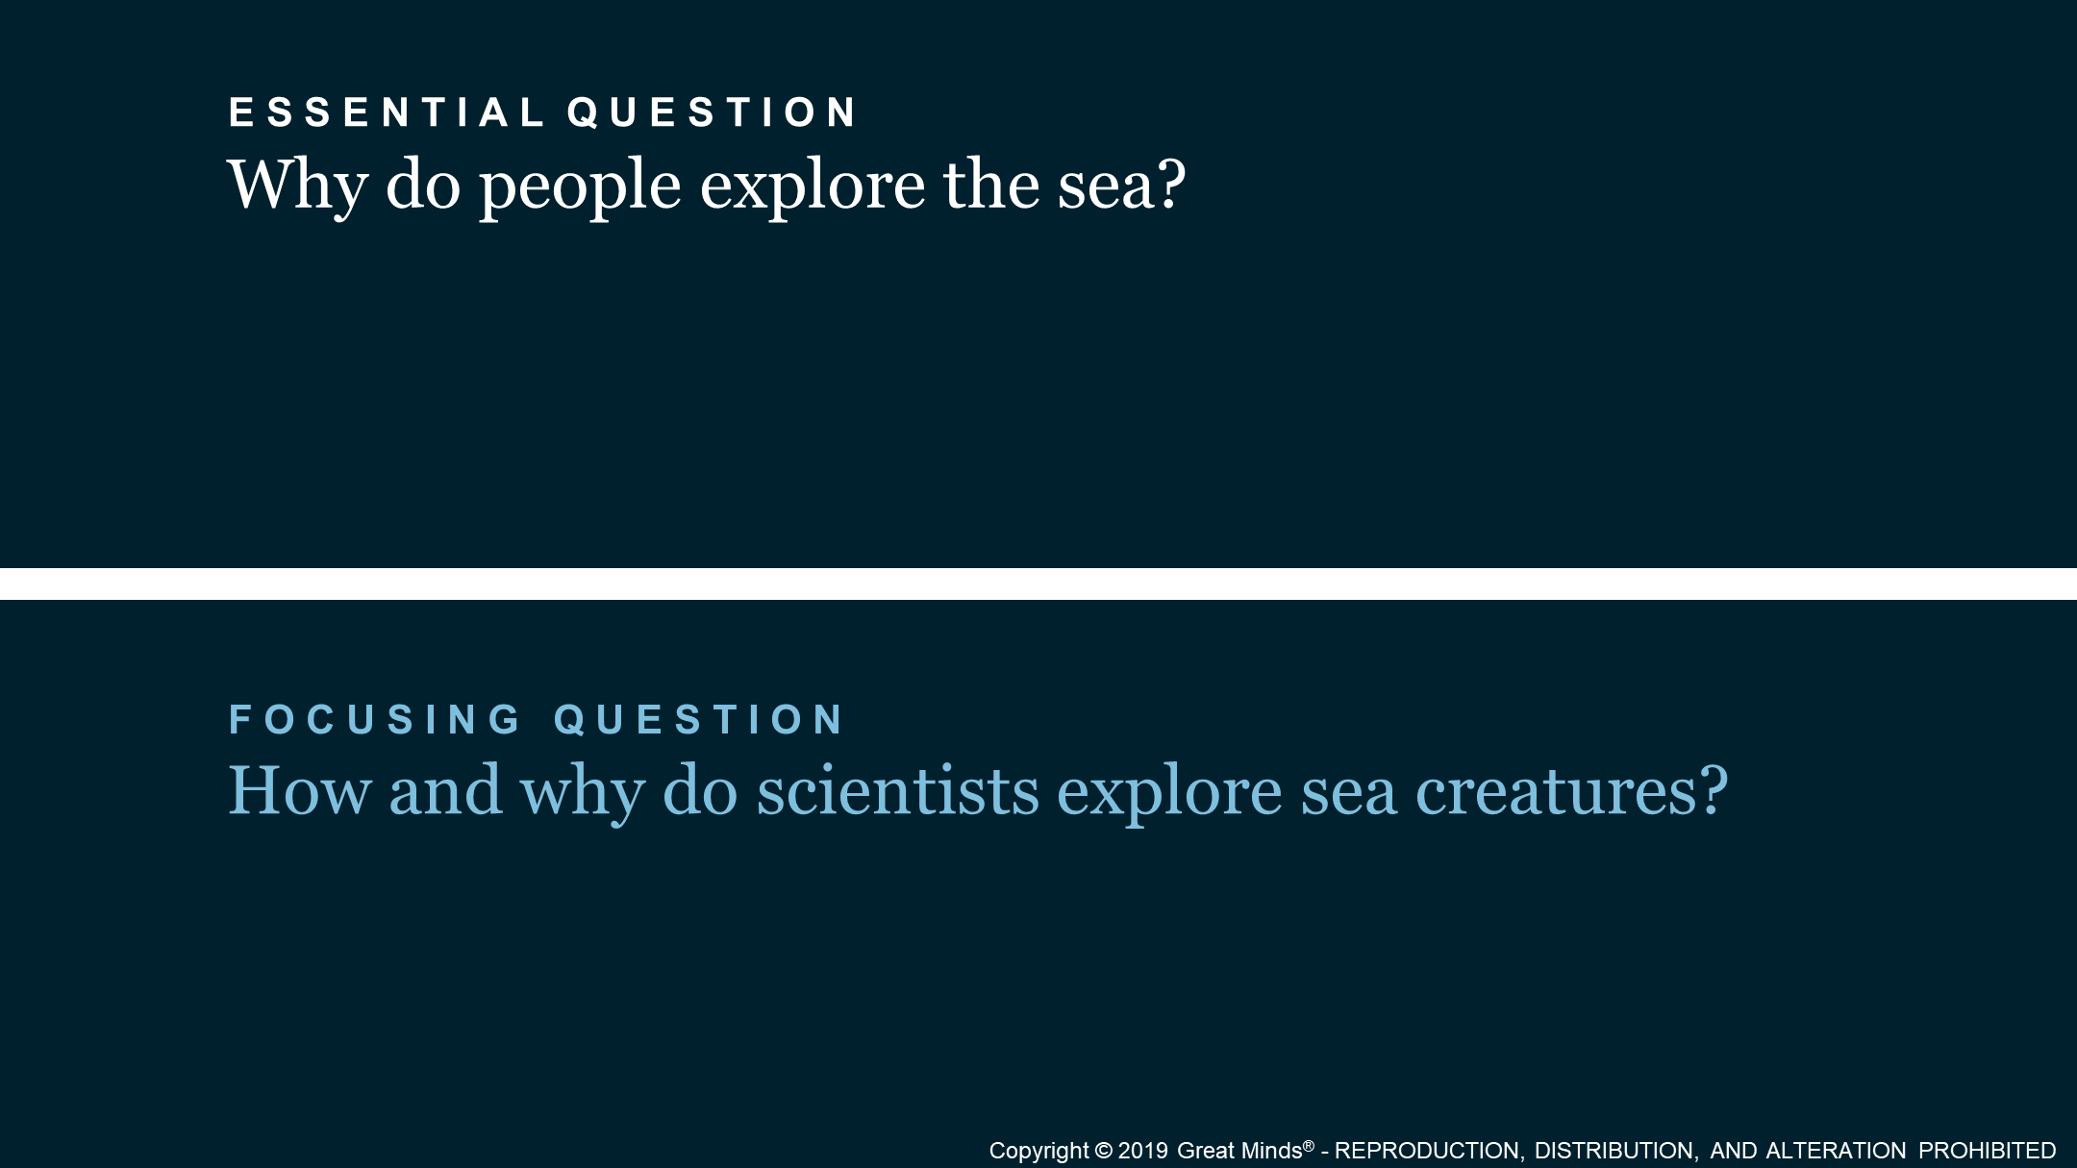
Notes:
Launch 2/3
Pacing Suggestion: 1 min.
Grouping: Whole Group
Teacher Actions
Read aloud the Focusing Question.
Explain to students that their learning in the Focusing Question arc will allow students to develop a topic using facts, definitions, and details around the importance of how and why scientists explore sea creatures.

Slide 11
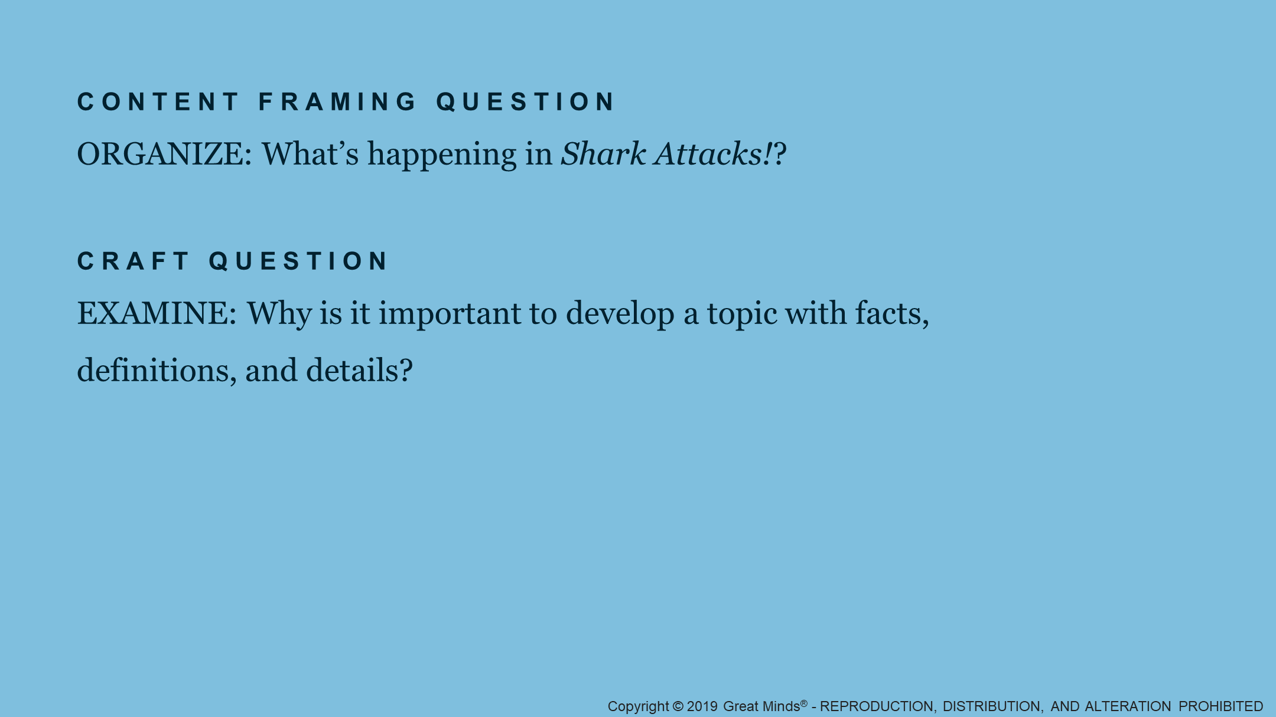
Notes:
Launch 3/3
Pacing Suggestion: 2 min.
Grouping: Whole Group
Teacher Actions
Read aloud the Content Framing Question.
Remind students that in the last lesson, they focused on asking and answering questions about sharks from the text Shark Attack! Today, students focus on understanding what is happening in the chapter “Shark Attacks—The Facts.”
Read aloud the Craft Question.

Slide 12

Notes:
Learn: Organize
Pacing Suggestion: 0 min.
Grouping: Whole Group
Teacher Actions
Tell students they begin to understand what’s happening in “Shark Attacks—The Facts” as they practice their listening skills with a Read–Aloud of the chapter.

Slide 13
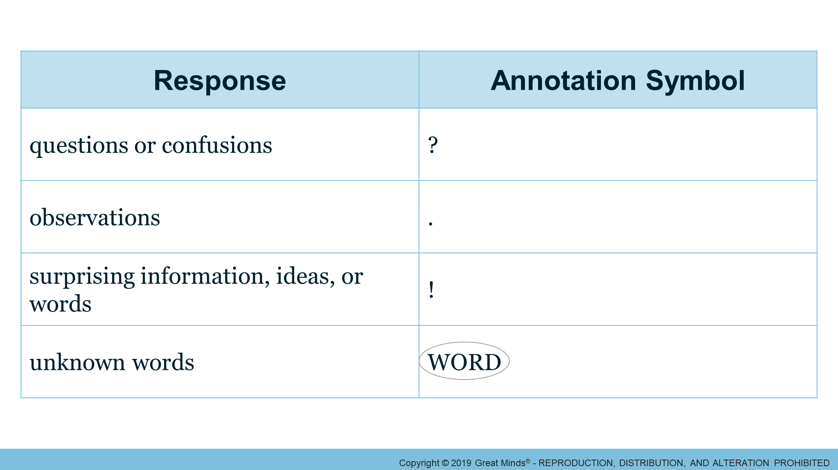
Notes:
Learn: Listen to a Text Read Aloud 1/3
Pacing Suggestion: 8 min.
Grouping: Whole Group
Teacher Actions
Distribute sticky notes.
Tell students to use sticky notes to annotate their texts.
Read the designated chapters aloud, modeling the elements of fluent reading.

Slide 14
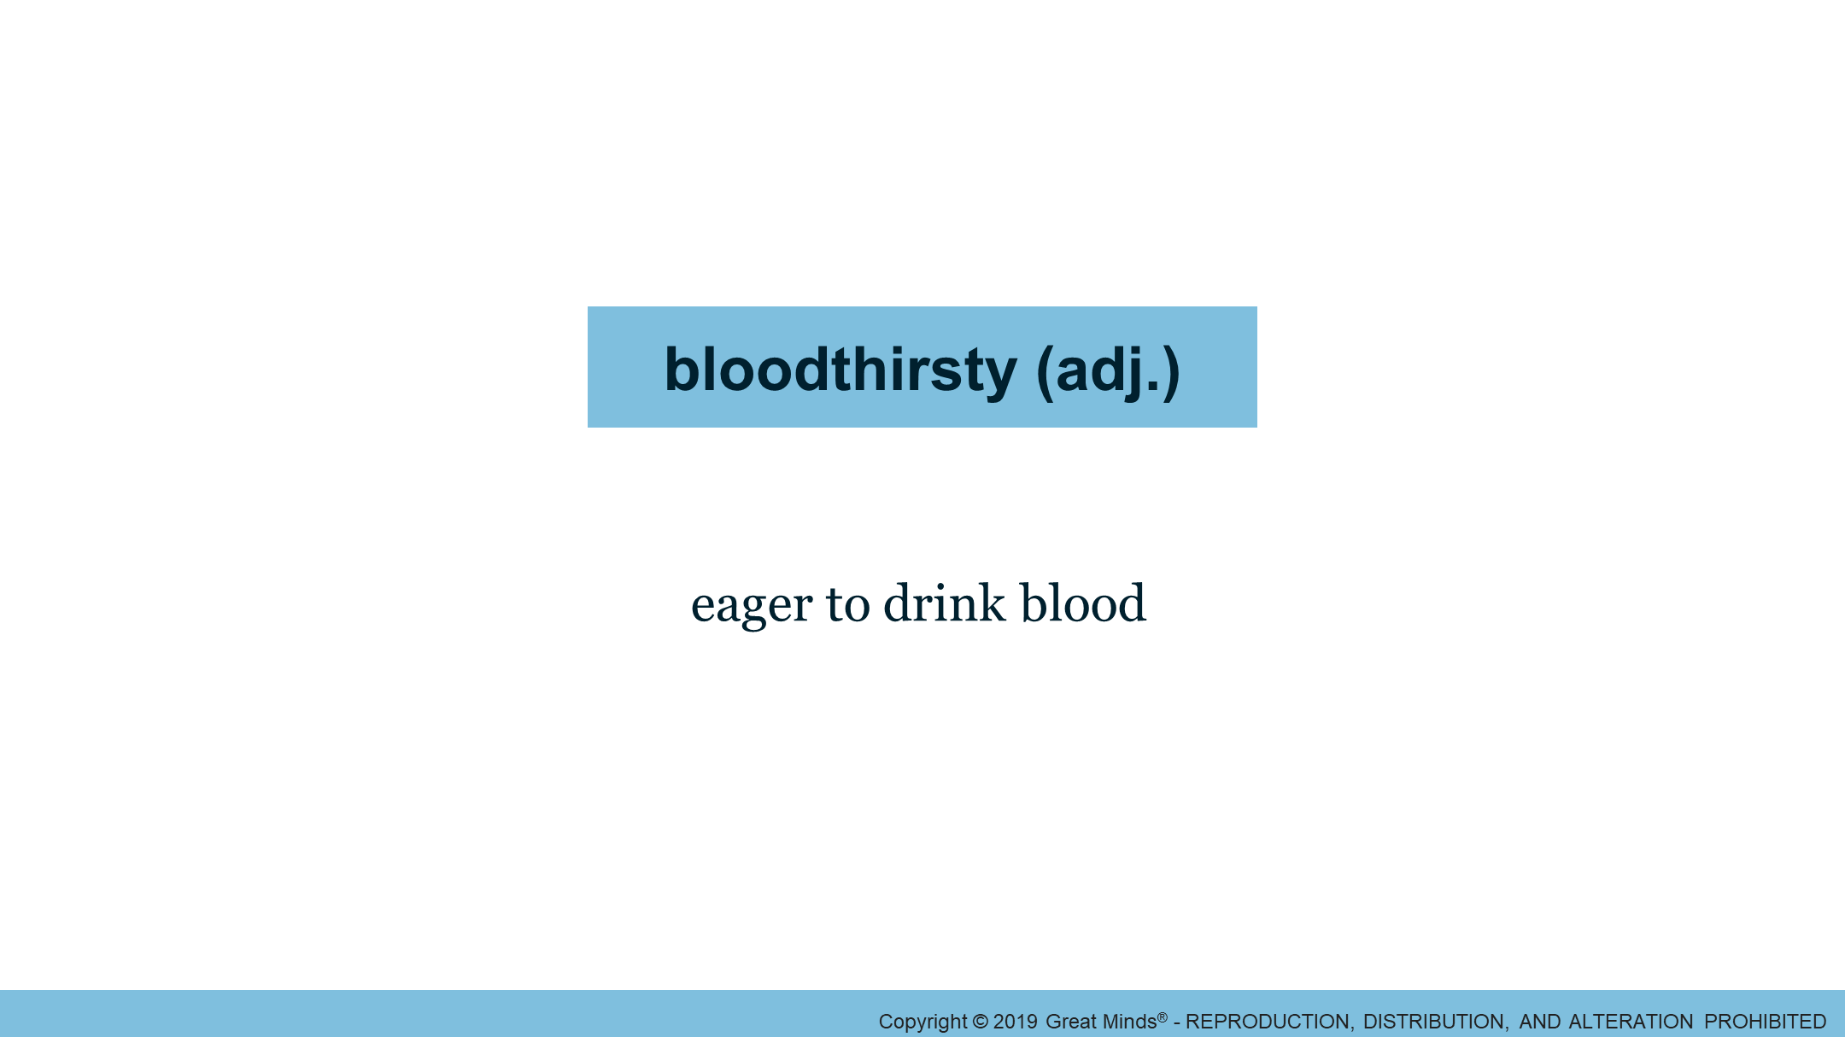
Notes:
Learn: Listen to a Text Read Aloud 2/3
Pacing Suggestion: 1 min.
Grouping: Whole Group
Teacher Actions
Review the definition of bloodthirsty.
Have students add the definition into the New Word section of their Vocabulary Journal.

Slide 15
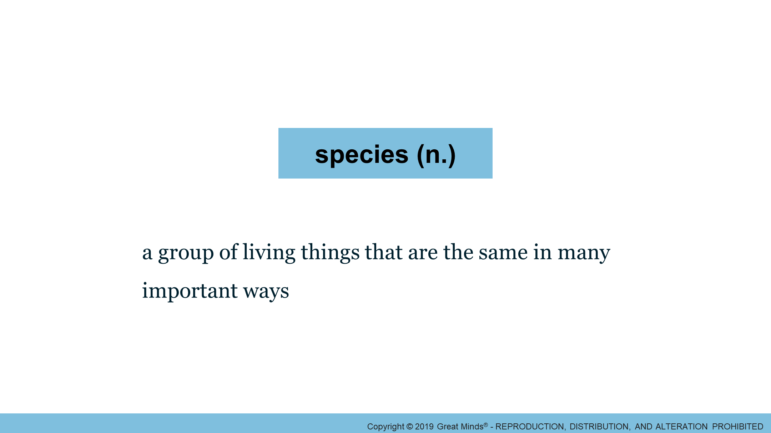
Notes:
Learn: Listen to a Text Read Aloud 3/3
Pacing Suggestion: 1 min.
Grouping: Whole Group
Teacher Actions
Review the definition of species.
Have students add the definition into the New Word section of their Vocabulary Journal.

Slide 16
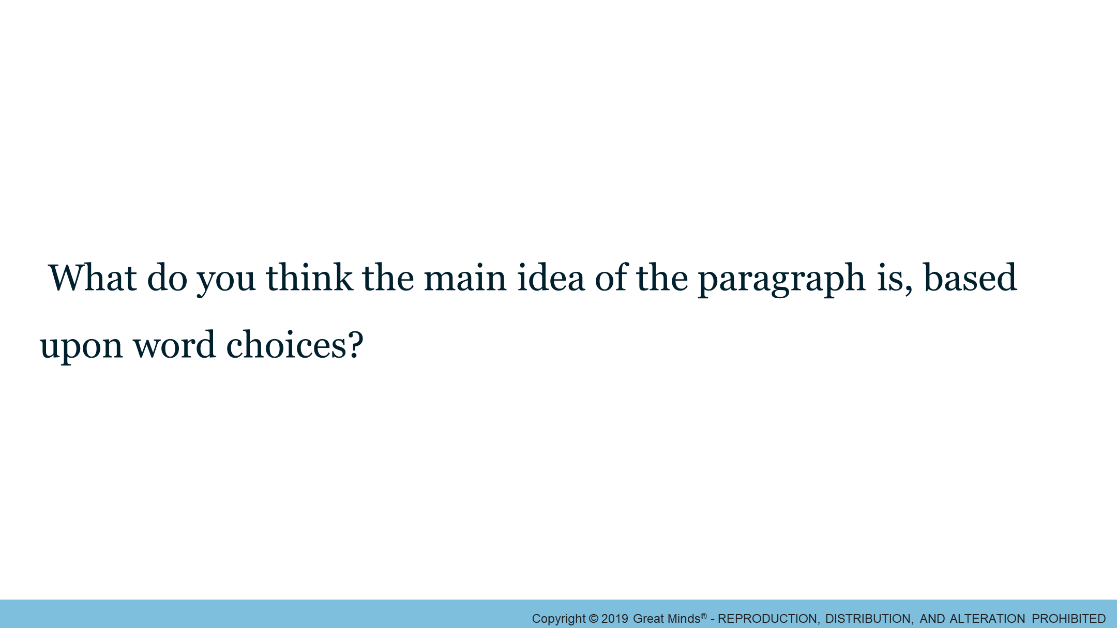
Notes:
Learn: Identify the Main Idea and Key Details in a Paragraph 1/4
Pacing Suggestion: 3 min.
Grouping: Whole Group
Teacher Actions
Direct students to refer to the first paragraph on page 16 to answer the question on the slide.
Chart responses and guide discussion.

Slide 17
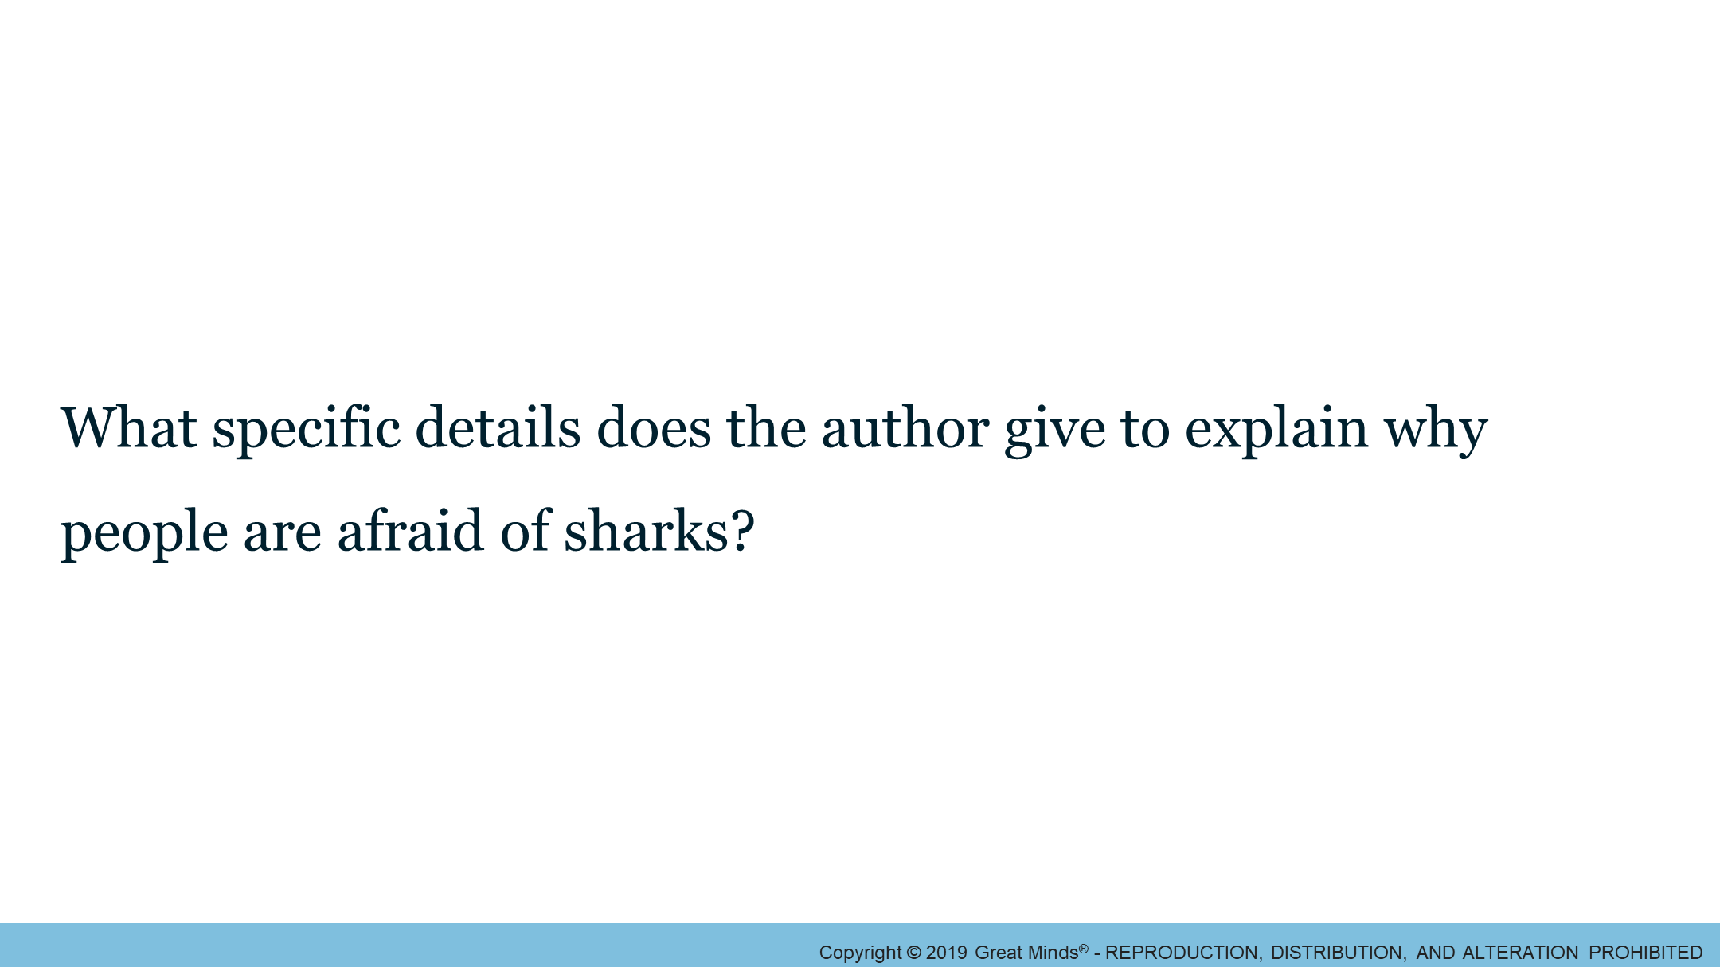
Notes:
Learn: Identify the Main Idea and Key Details in a Paragraph 2/4
Pacing Suggestion: 2 min.
Grouping: Whole Group
Teacher Actions
Chart student responses, and guide discussion.

Slide 18
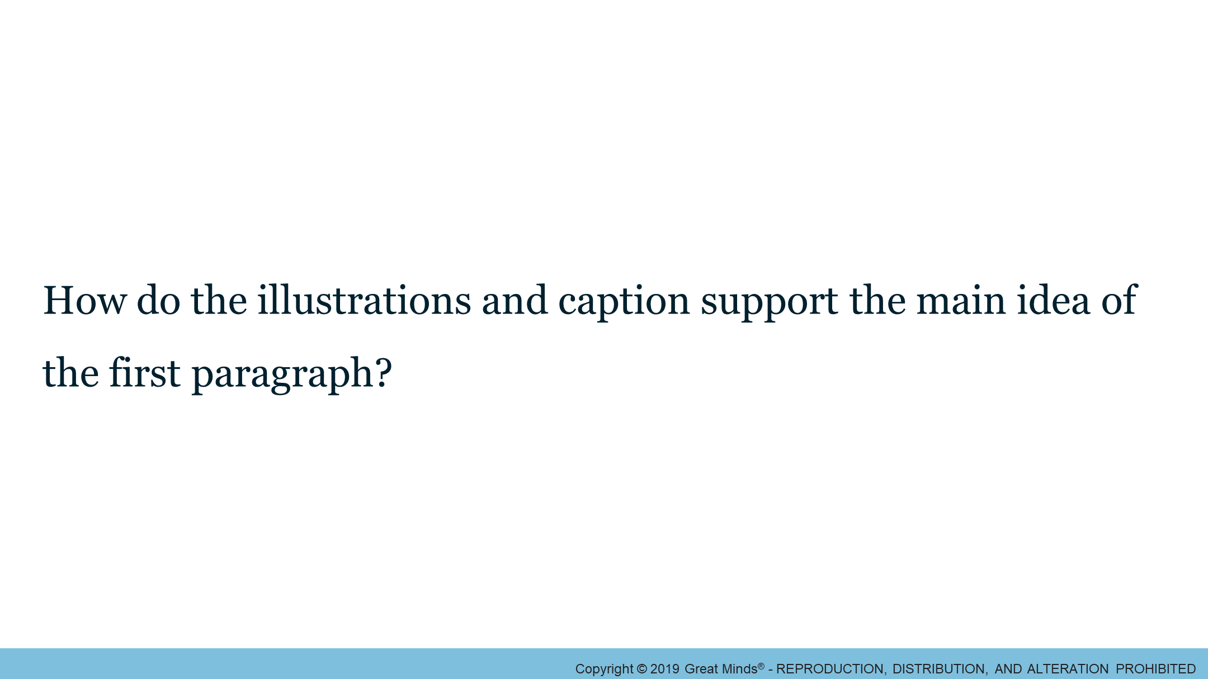
Notes:
Learn: Identify the Main Idea and Key Details in a Paragraph 3/4
Pacing Suggestion: 2 min.
Grouping: Whole Group
Teacher Actions
Chart student responses, and guide discussion.

Slide 19
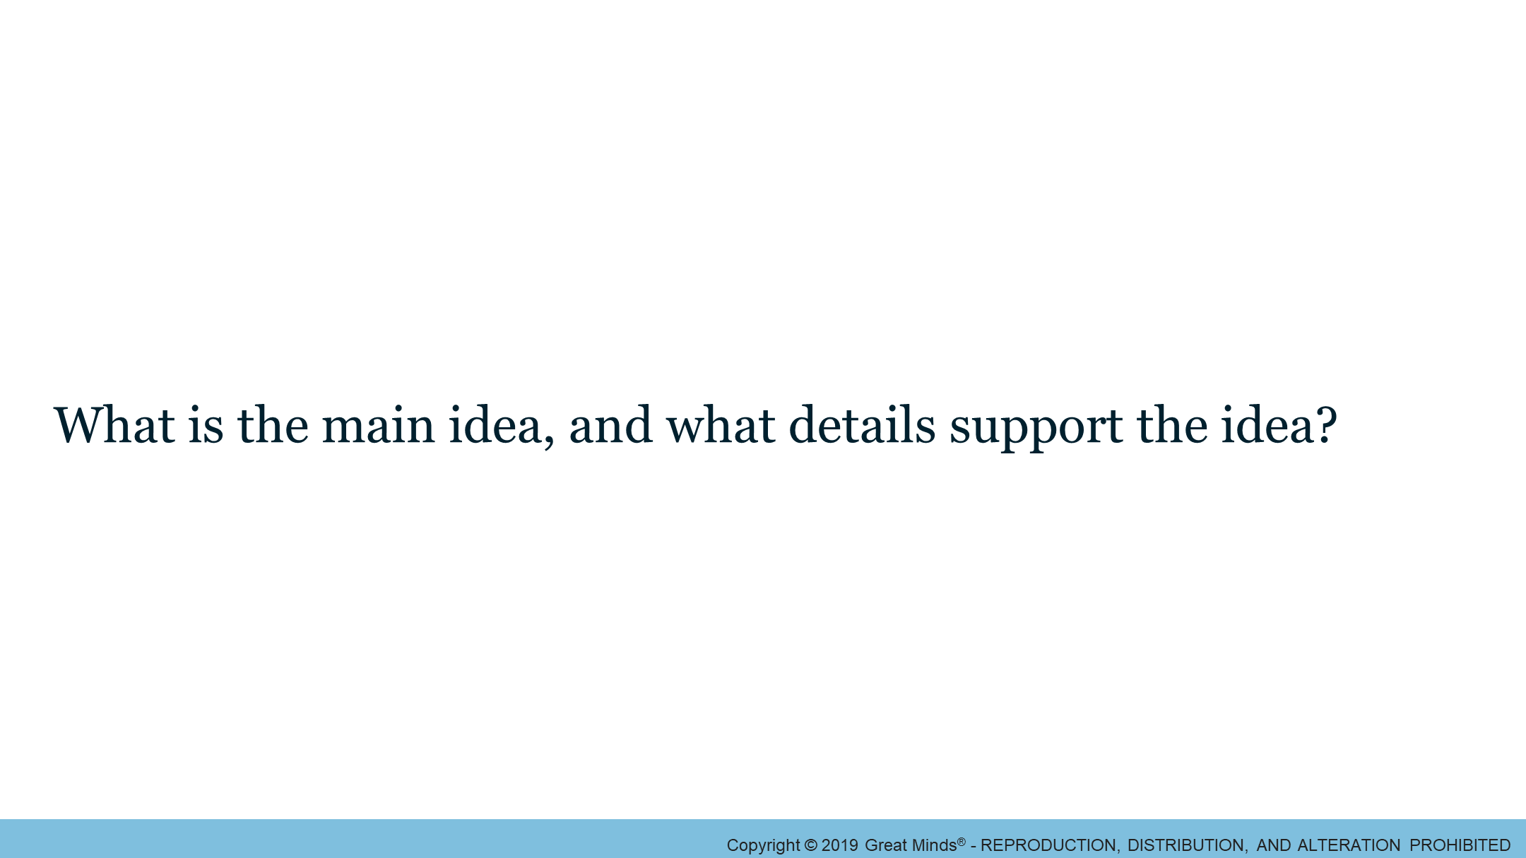
Notes:
Learn: Identify the Main Idea and Key Details in a Paragraph 4/4
Pacing Suggestion: 3 min.
Grouping: Whole Group
Teacher Actions
Direct students to refer to the second paragraph on page 16 to answer the question on the slide.
Chart student responses, and guide discussion.

Slide 20
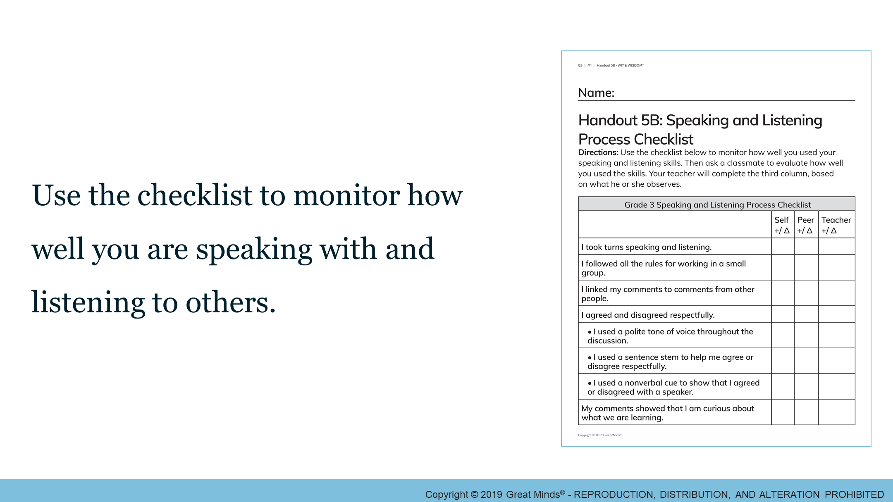
Notes:
Learn: Identify the Main Idea and Key Details in a Passage 1/2
Pacing Suggestion: 4 min.
Grouping: Small Groups
Teacher Actions
Divide students into small groups.
Direct students to Handout 5B.
Assign each group one of the text excerpts on page 17, pages 18–19, page 20, page 21, pages 22–23, or pages 24–25. More than one group may analyze the same excerpt, if needed.
As students work in small groups, provide feedback on this form for students. Encourage them to complete it along the way as well.
When students complete their small group work, have them finish assessing their work for any areas they have not already completed.

Slide 21
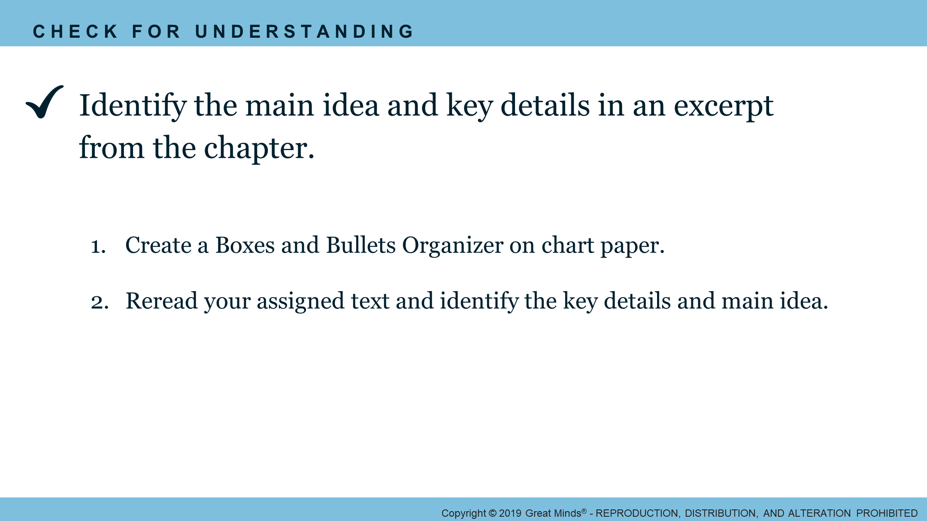
Notes:
Learn: Identify the Main Idea and Key Details in a Passage 2/2
Pacing Suggestion: 9 min.
Grouping: Small Groups
Teacher Actions
Distribute chart paper and markers to each group.
Review the CFU directions.
After each group has completed their Boxes and Bullets Organizer, collaboratively identify key details from the chapter and identify the main idea of the chapter for class display.
Support Note: Reading
Have students who read at grade level read independently.
Follow this reading protocol with students who need support:
1st Read—Read aloud to model fluent reading while students follow along with their eyes on the text.
2nd Read—Choose one of the following options:
Read aloud a second time to model fluent reading.
Pair students. Student 1 reads aloud, and student 2 follows along with eyes on the text. Students switch roles after the first text.
Provide an audio recording. Students listen and follow along with eyes on the text.

Slide 22
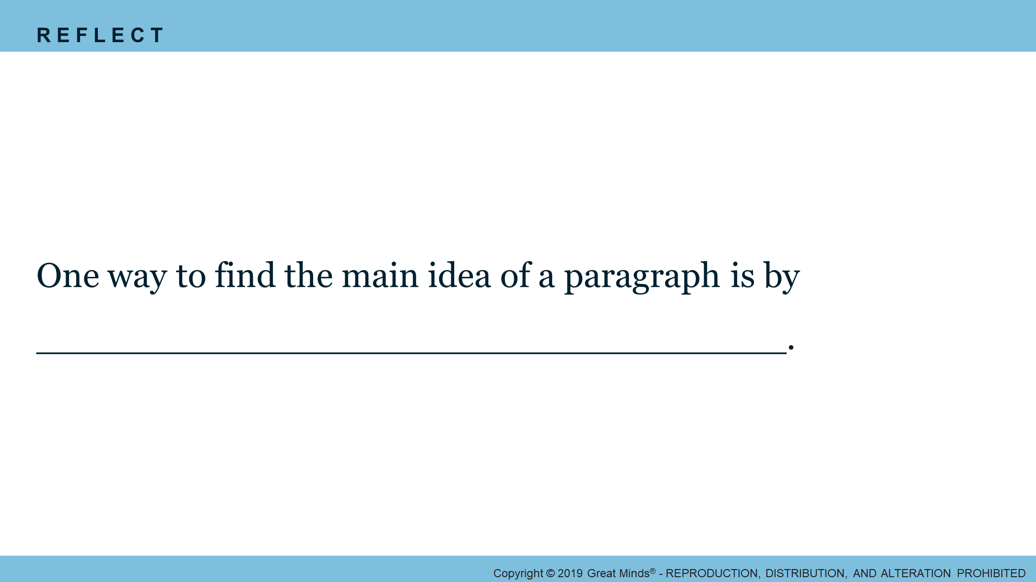
Notes:
Reflect: Main Idea
Pacing Suggestion: 1 min.
Grouping: Whole Group
Teacher Actions
Have students record their responses, and/or facilitate a brief whole group discussion.

Slide 23
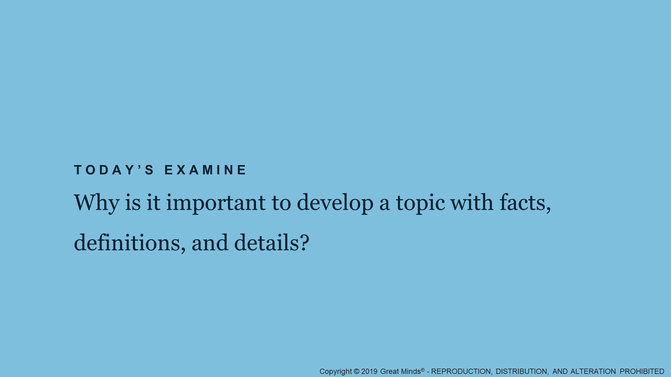
Notes:
Learn: Examine
Pacing Suggestion: 0 min.
Grouping: Whole Group
Teacher Actions
Tell students they have looked at what is happening in the chapter “Shark Attacks—The Facts.”
Explain that they now examine how to develop a topic with facts, definitions, and details.

Slide 24
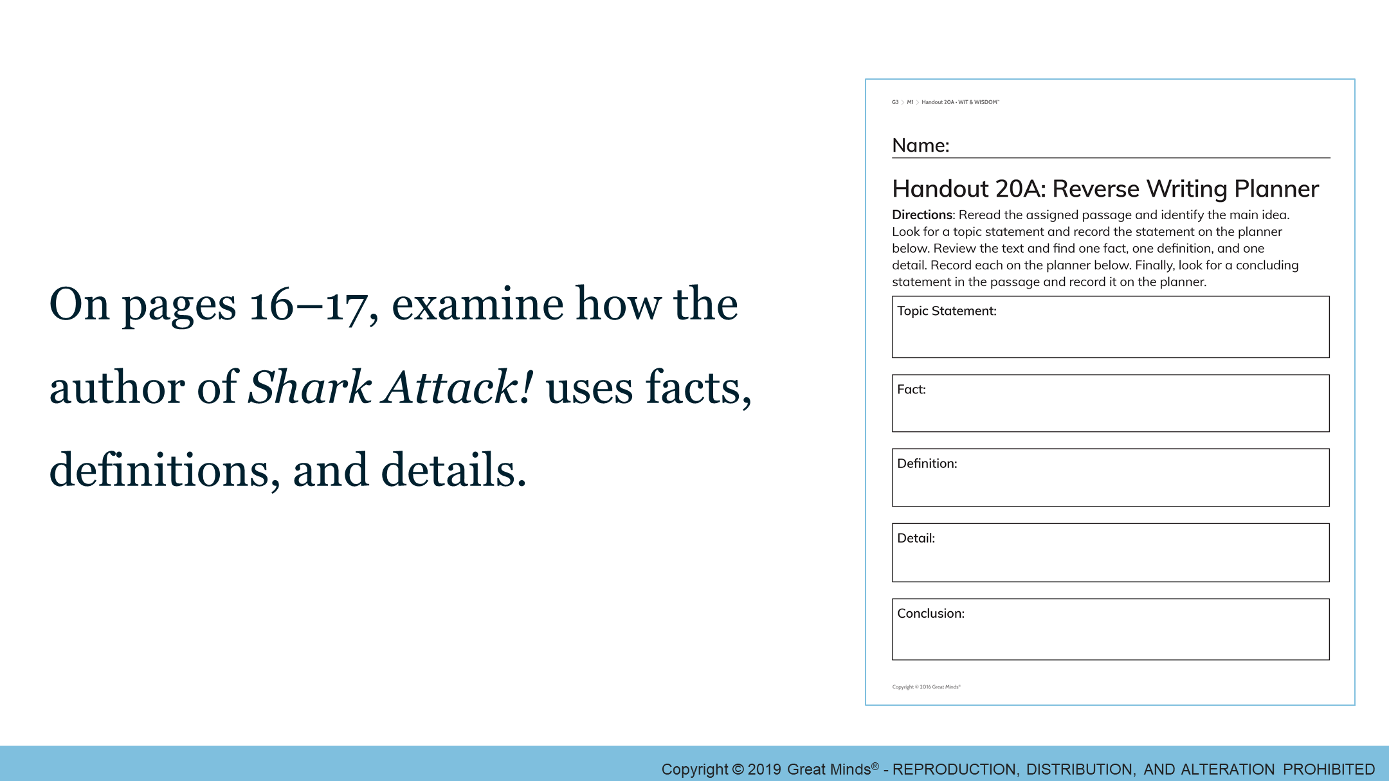
Notes:
Learn: Examine How to Develop a Topic Using Facts, Definitions, and Details 1/2
Pacing Suggestion: 15 min.
Grouping: Whole Group
Teacher Actions
Review the Describe Your Knowledge to a TEE Anchor Chart.
Point out that each topic statement is supported by evidence.
Explain that three main types of evidence are facts, definitions, and details.
Direct students to Handout 20A. Collaboratively complete the handout.

Slide 25
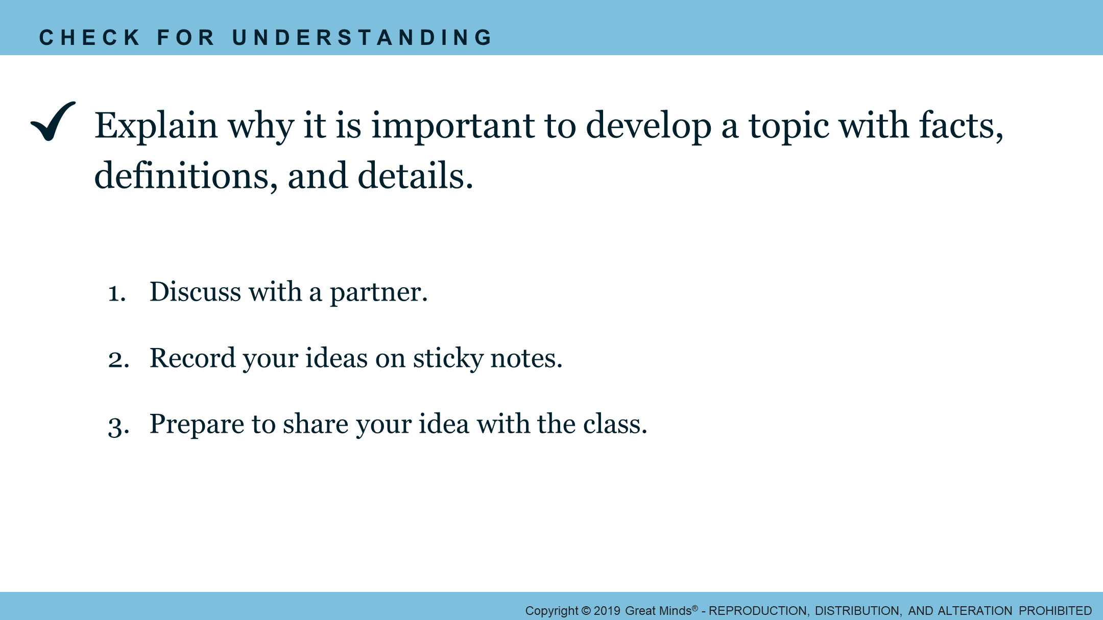
Notes:
Learn: Examine How to Develop a Topic Using Facts, Definitions, and Details 2/2
Pacing Suggestion: 5 min.
Grouping: Pairs
Teacher Actions
Pair students.
Distribute sticky notes, and remind students of guidelines for a Whip Around.
Review the CFU directions.

Slide 26
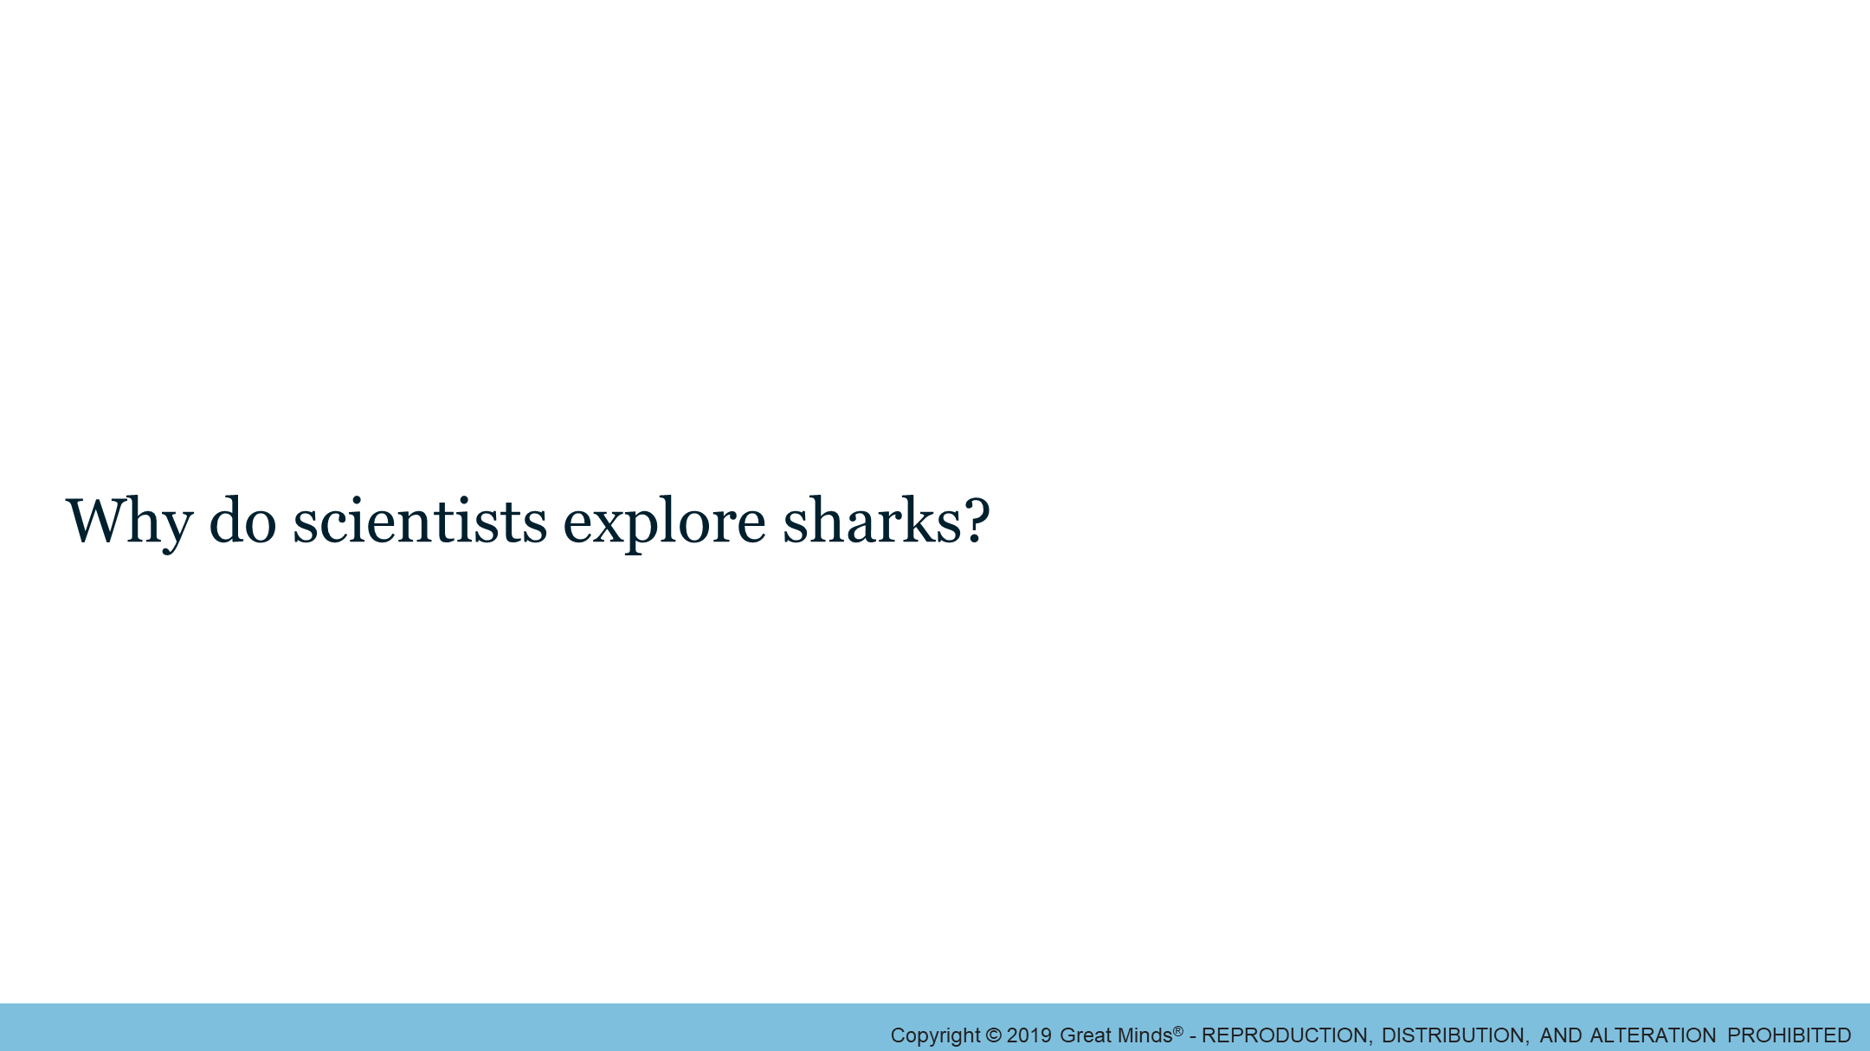
Notes:
Land 1/1
Pacing Suggestion: 5 min.
Grouping: Pairs
Teacher Actions
Instruct students to shares responses with a partner.
Remind students to review the text and their notes in order to explain their reasoning.
Remind students to only use information from the chapter, not the text as a whole.

Slide 27
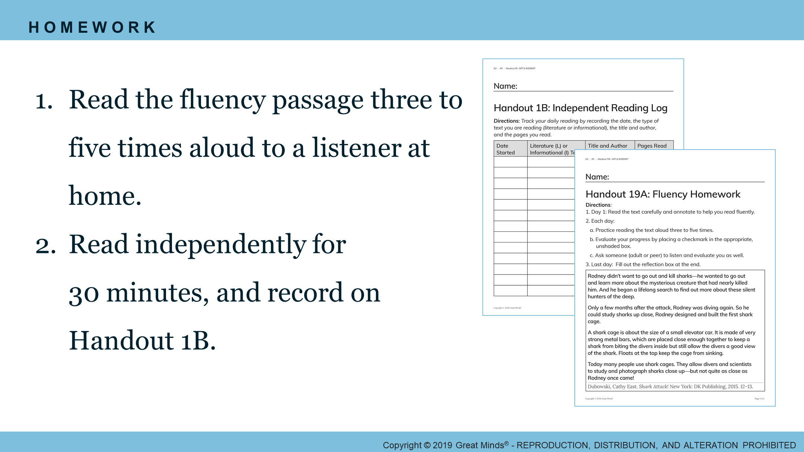
Notes:
Wrap: Assign Homework 1/1
Pacing Suggestion: 5 min.
Grouping: Whole Group
Teacher Actions
Direct students to Handout 1B and Handout 19A.
Assign homework.

Slide 28
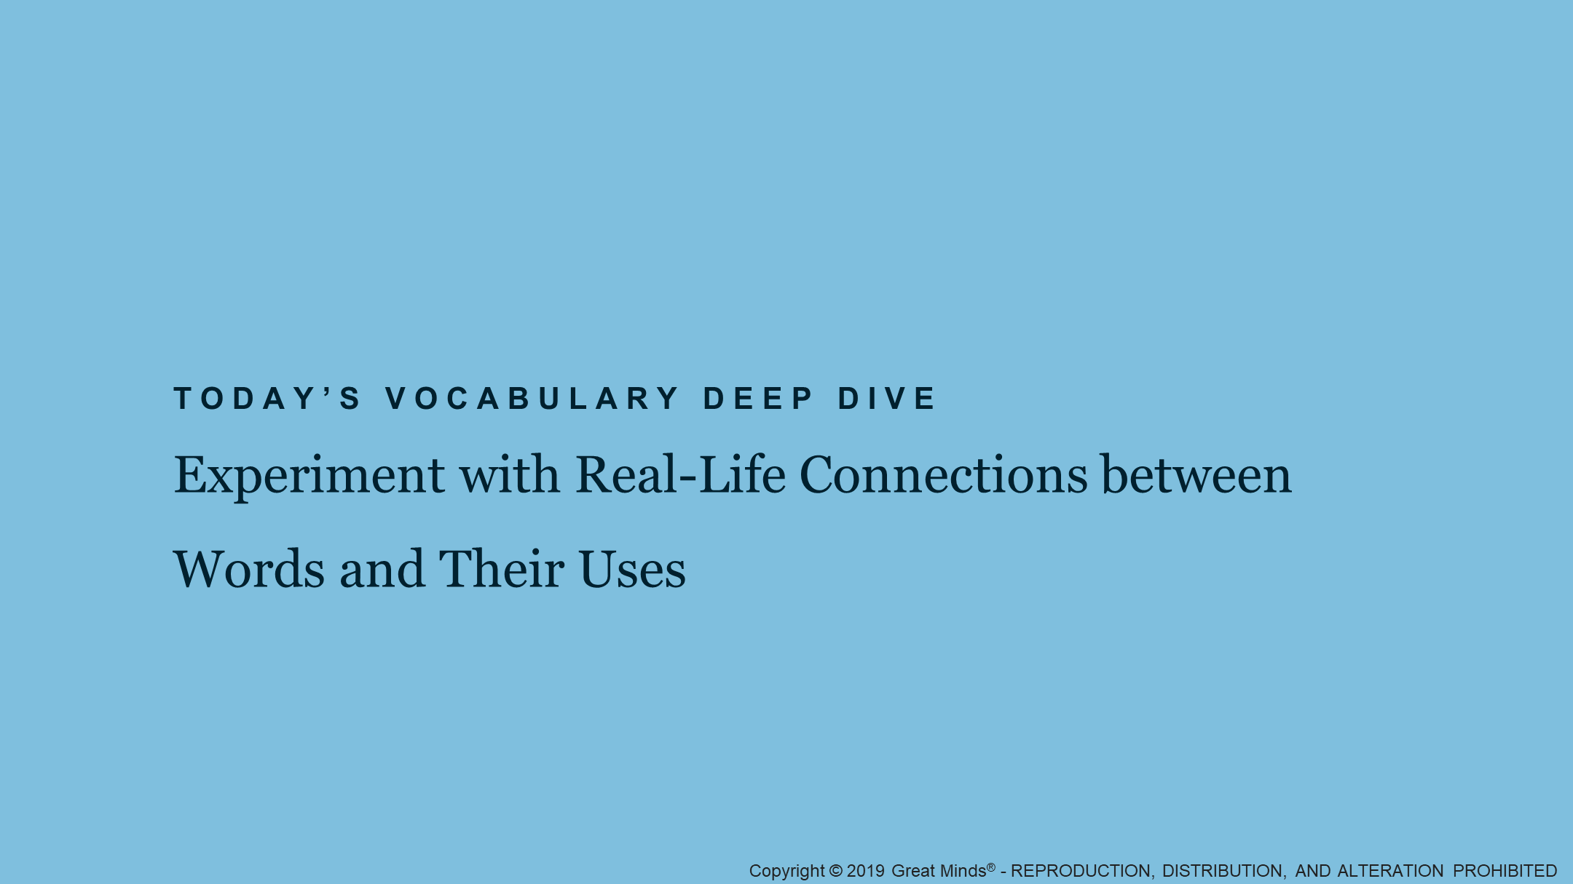
Notes:
Deep Dive: Vocabulary
Pacing Suggestion: 0 min.
Grouping: Whole Group
Teacher Actions
Tell students they will begin to practice making real-life connections between words and their uses related to the ocean’s food chains.

Slide 29
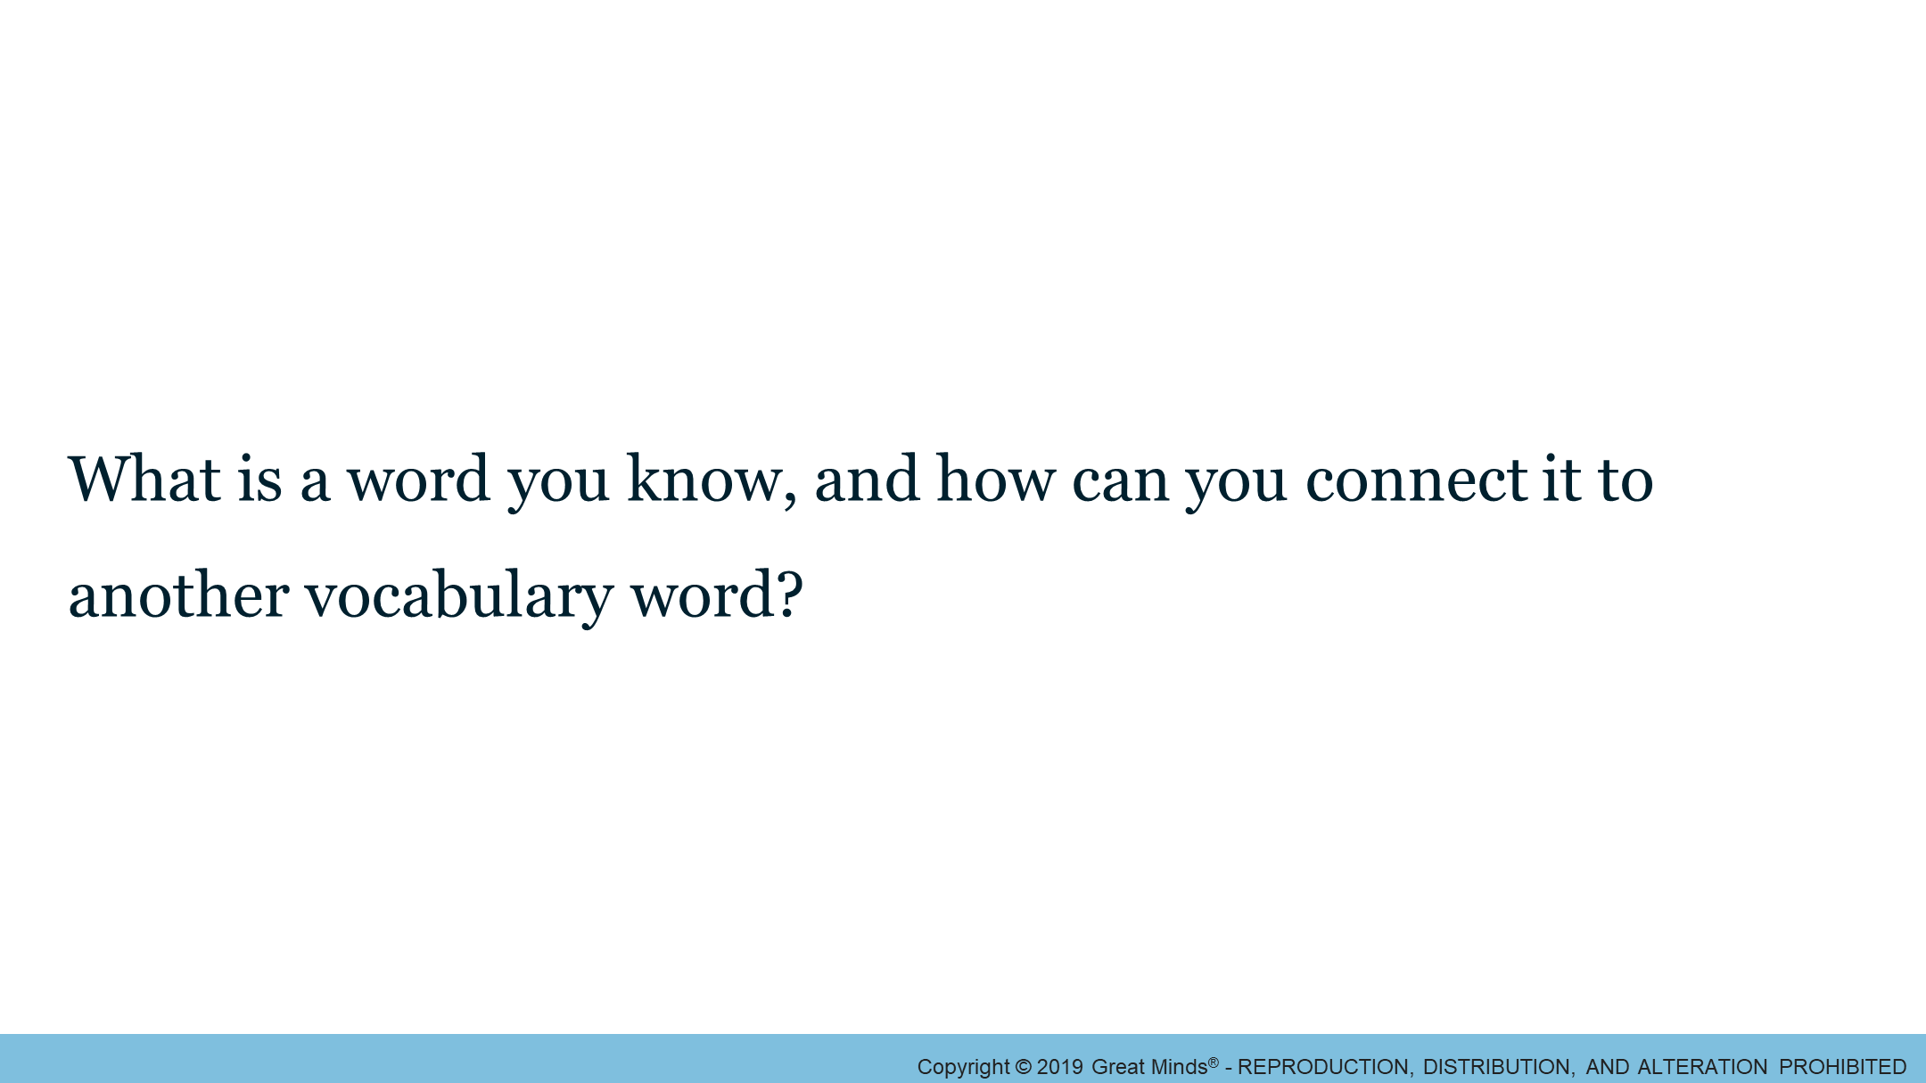
Notes:
Deep Dive Launch/Learn 2/2
Pacing Suggestion: 6 min.
Grouping: Whole Group
Teacher Actions
Place large cards vocabulary words on the floor.
Guide students to answer prompt by manipulating the cards for the concept map.

Slide 30
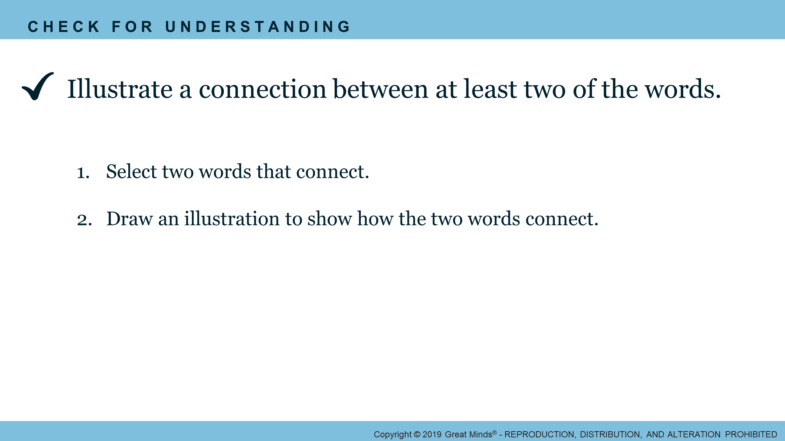
Notes:
Deep Dive: Land 1/1
Pacing Suggestion: 9 min.
Grouping: Whole Group
Teacher Actions
Distribute blank paper.
Review the CFU directions.
Locate a place in the classroom to display images to reference throughout the rest of the module.

Slide 31
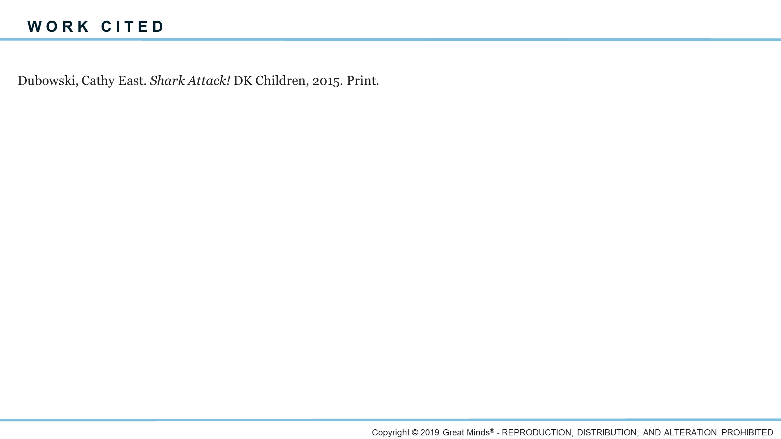

Slide 32
